Slide 1
Convert PDU messages into Samples
Goals:
-Configure a network interface on the host system (TUNTAP device), read bytes from the interface convert them into samples and use it as our input in the BFSK or BPSK to transmit it to the other computer.
-The demodulation side receives the messages and write bytes into the interface on the other side.

Slide 2
What is a network interface ?
Connection: Refers to pieces of related information transfered through a network.
Packets: Envelopes that carry data from one end point to the other.
Network interface: Software interface that makes an interconnection between a computer and a private or public network.
Network layer: Route data between different nodes on the network.
Interfaces: networking communication points for your computer.

Slide 3
What is a Tun/Tap network interface ?
Virtual interfaces created by Linux.
A network device usually has a physical device associated with it to put packets on the wire.
However Tun or Tap devices are virtual and managed by a kernel.
User space applications can interact with TUN and TAP devices as if they were associated with a physical device, and the OS will inject packets into the network stack.

Slide 4
How we can use Tun/Tap Devices
-We can use Tap devices, configure a Tap device to work at the Ethernet level and behave like a network adapter.
-With the configured Tap devices we can “virtually connect” to Gnuradio. We can use ssh (communication protocol) into the Tap IP address. This will input bytes into the network interface.

Slide 5
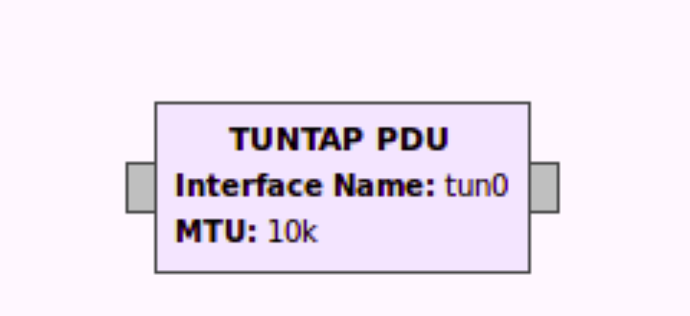
TUN/TAP gnuradio block
There is a block in gnuradio that allow us to set a tuntap device that outputs PDUs
PDU is the term for protocol data unit: refers to a group of information added or removed by a layer in the OSI model.
For Layer 2 it is a frame, the PDU has four fields destination service access point, source service access point, control field and information field.

